Slide 1

We help machines make decisions
ASK Labs Company

Slide 2
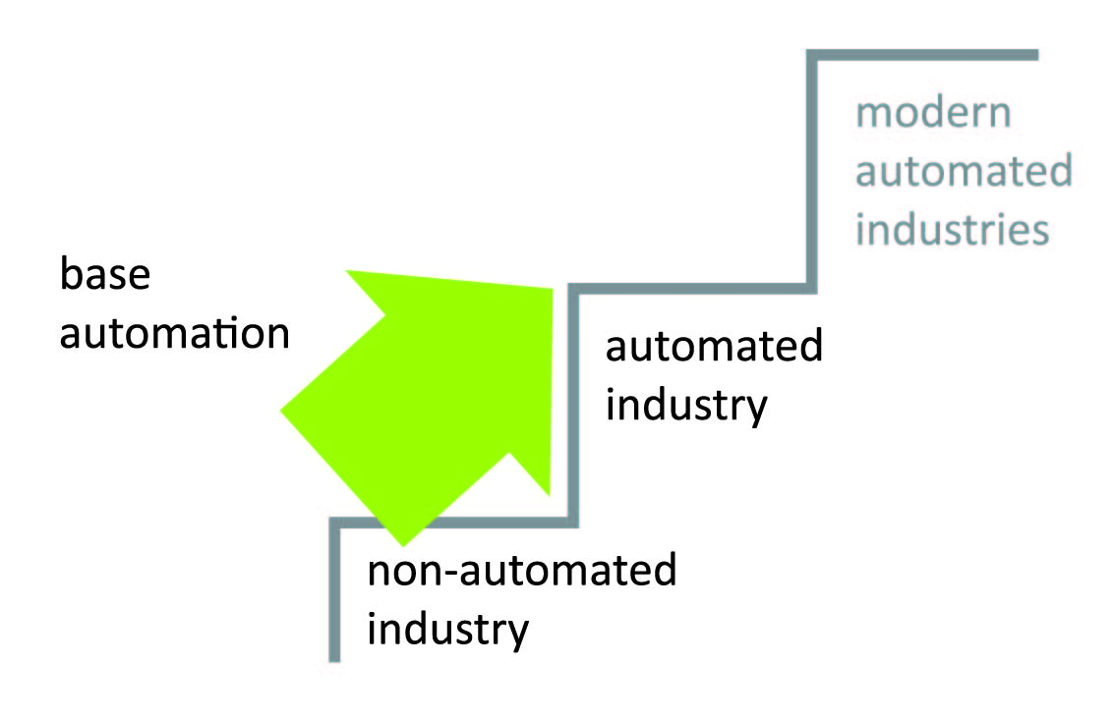
Industrial automation became a stage of development of scientific and technical progress
Base automation deployment on manufacture in the middle of the last century became a considerable stage in development of scientific and technical progress, promoted labor productivity increase, improvement of production quality, management optimization, elimination of the person from the manufactures which are hazardous to health.

Slide 3
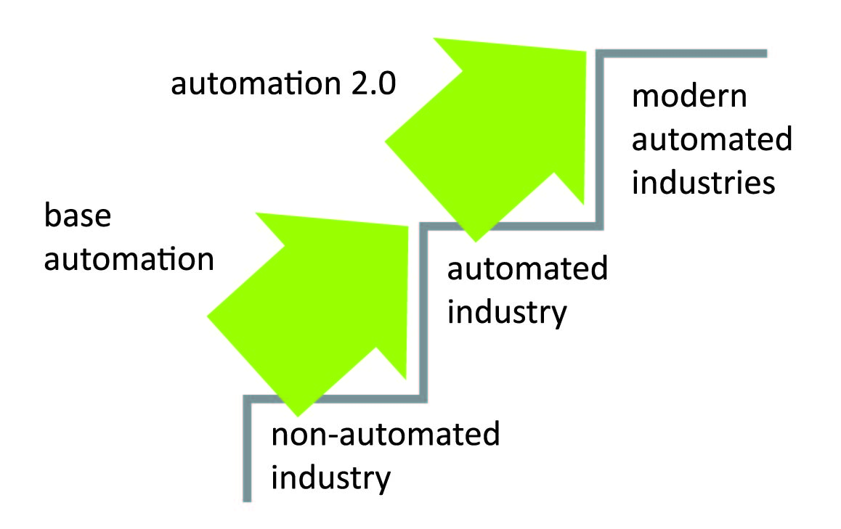
New stage of industrial automation development
Today we are on the threshold of a new coil of scientific-technical progress which will deduce industrial production automation on new level.
This coil became possible thanks to deployment of variety of innovative technologies which we unite under the name «Automation 2.0»

Slide 4
Automation 2.0
To meet the new demands of the market, ASK Labs has developed a product line under the title Automation 2.0.
Software and hardware, includes both the proprietary software and third-party equipment manufacturers

Slide 5
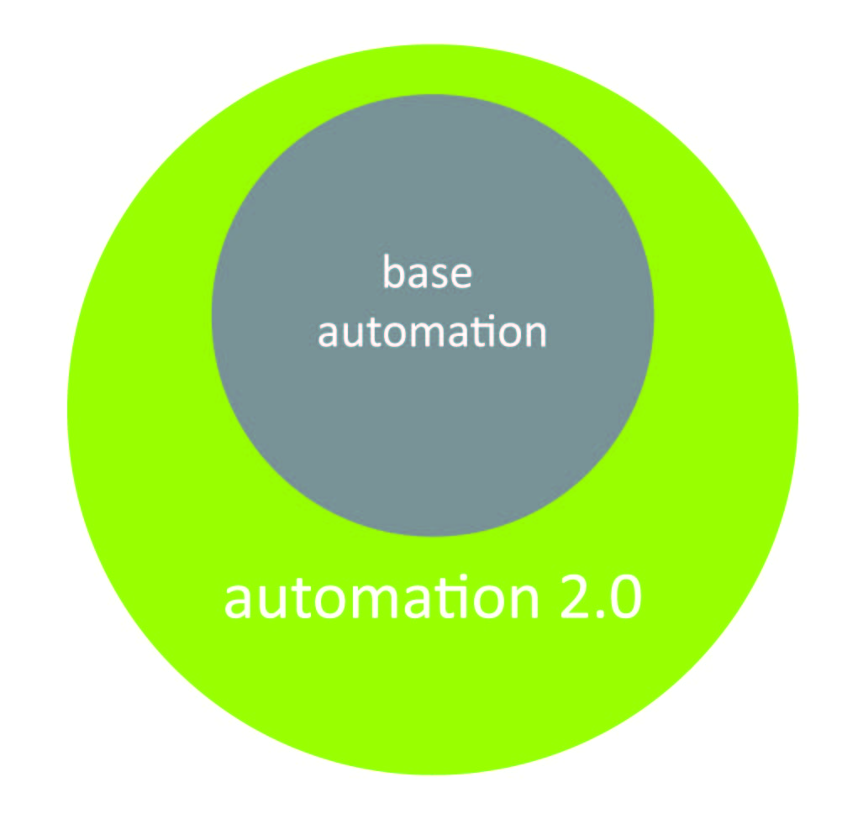
Automation 2.0 advantages compared with traditional industrial control
What advantages are given to manufacture by deployment of innovative technologies and algorithms of automation?
Automation 2.0 copes with problems with which traditional industrial control doesn't cope.
Automation 2.0 allows to automate multidimensional processes.
Automation 2.0 allows to achieve economic benefit where it can't be made methods of base automation.

Slide 6
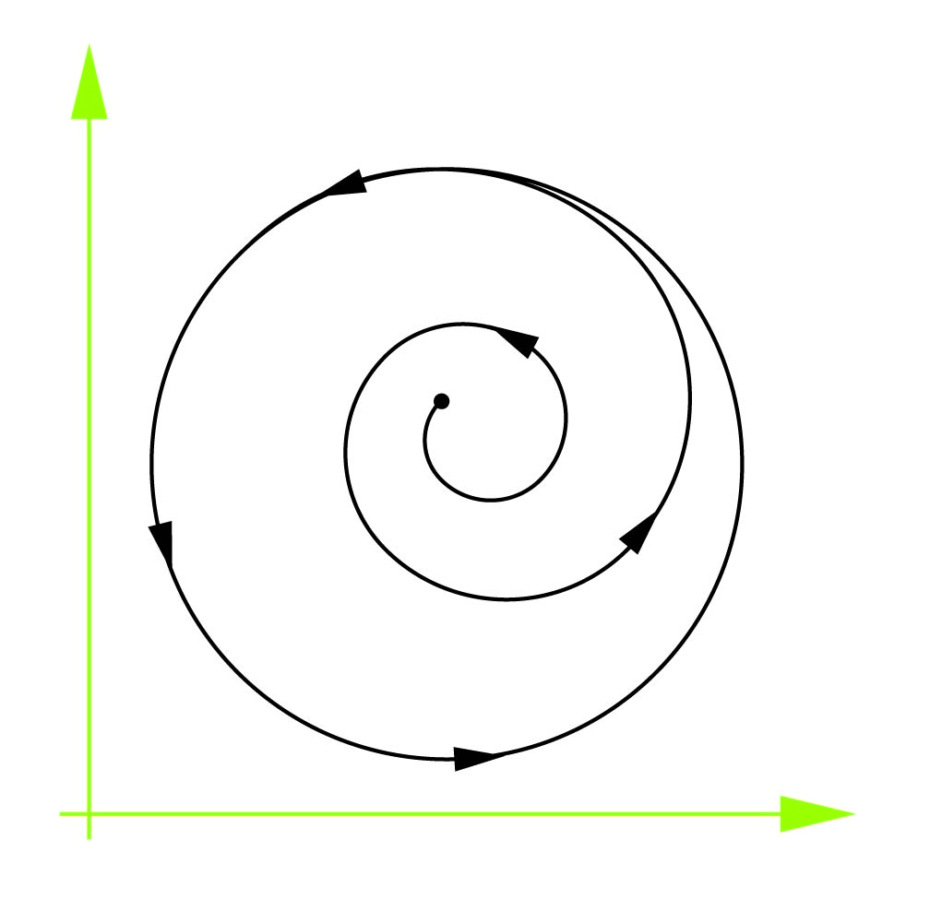
New technologies solve problems which not on forces traditional industrial control
The new technologies united under the name «Automation 2.0» cope with following tasks:
Astable, noisy technological processes.
The processes representing a number of alternating modes of steady and unstable movements and self-oscillations.
Nonlinear processes.

Slide 7
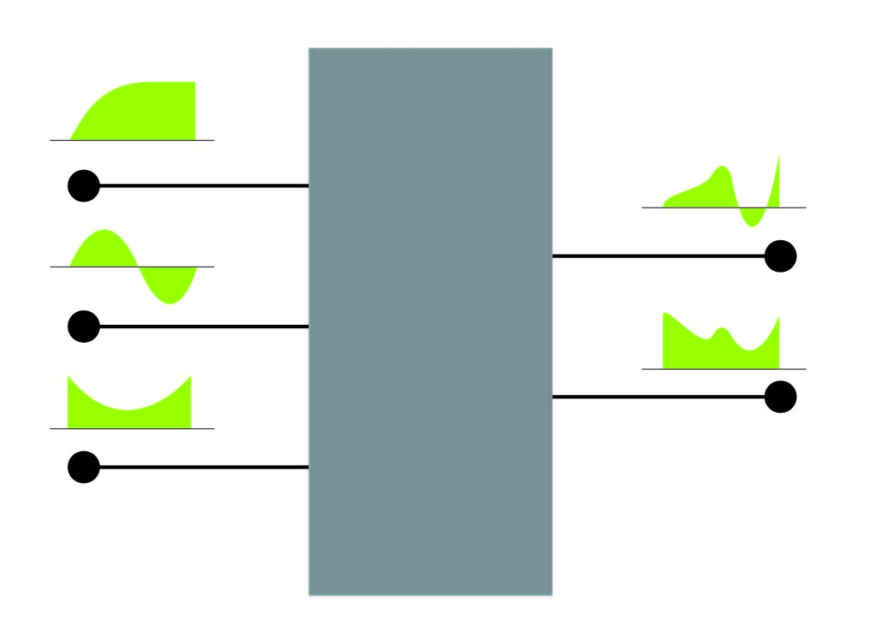
Multidimensional processes automation
Automation 2.0 allows to automate multidimensional processes:
The processes depending on several input variables and described by several output variables.
There can be difficult dependences between variables .
Technological process can make inconsistent demands to variables.

Slide 8
What an essence of the innovative approach used in Automation 2.0?
The Automation 2.0 key moment is model construction of technological process. For model construction algorithms of artificial intelligence are used due to which possible to operate multidimensional astable processes with difficult nonlinear dependences , to predict a course of technological process, to stabilize technological process and to find the optimal operating mode for it.

Slide 9
The technological process forecast
The technological process forecast allows to realize a principle: «to operate with anticipation instead of to react to a deviation from norm». The prevention of deviations from an optimum operating mode allows to prevent foul-up, not to admit work the equipment in extreme modes, to prevent the excessive consumption of power resources and materials.

Slide 10
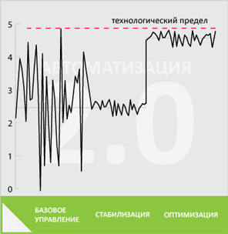
Optimization
The general approach to optimization of technological process in Automation 2.0:
At the first stage we reduce a range of deviations of technological process to minimum values,
At a following stage the optimum operating mode of technological process is calculated,
Then we shift a working range to a technological limit.

Slide 11
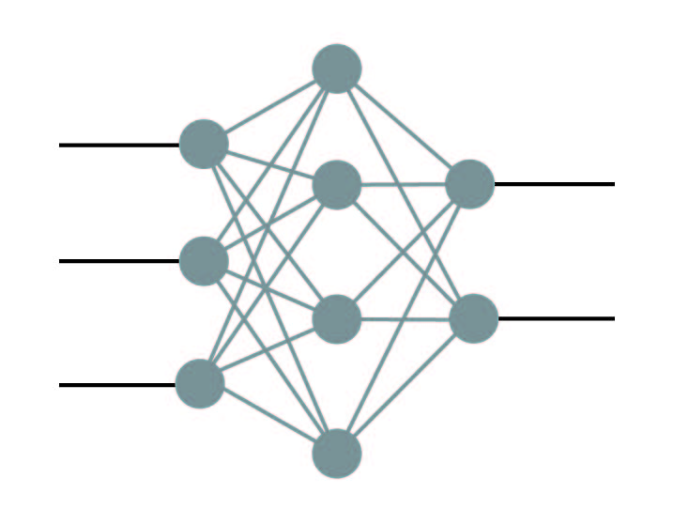
Modern mathematical algorithms
Modern mathematical algorithms are used in Automation 2.0 for model construction of technological process. Such as: fuzzy logic, neural networks and genetic algorithms, management by means of the simulated forecast, feedback system, expert systems, management by means of statistical models.

Slide 12
Use of computers in the industry
Wide application of Automation 2.0 innovative technologies are possible only owing to wide use of computers on manufacture as new technologies demands volume and fast calculations.
For the further development of Automation 2.0 ASK Labs has started development of the national software.

Slide 13
Economic benefit of deployment for the enterprises
Economic benefit of Automation 2.0 deployment depends on branch, automation level of the enterprise and other production factors. On the average it is possible to expect following effect from deployment in different sectors:
Refining
Petrochemical
Metallurgy
4…15%
3…12%
2…10%

Slide 14
The total economic effect
Experts calculations show that Automation 2.0 deployment of at least on 10 % of the enterprises of the oil, metallurgical and mining industry will give about $2 billions (60 billions RUB) total effect.
This effect develops from economy of power resources and materials, increase of labor productivity and production efficiency, decrease in deterioration of the equipment.

Slide 15






Alex Golovin
ASK Labs Company

