Slide 1

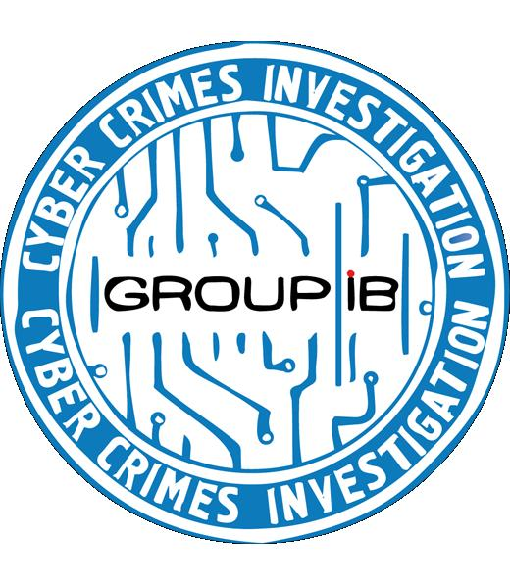

Group-IB: Digital investigations and forensic
Ilya Sachkov
Group-IB
sachkov@group-ib.ru
.

Slide 2
Group-IB
The first and only private company in Russia engaged in consulting in the field of computer crime investigation and computer forensics
Assistance to law enforcement authorities on particularly difficult cases
Since 2003
We have partners and researchers in 43 countries
Unique staff – 30 people
24\7 Incident response
Notes:
2

Slide 3
Problem №1: Information Security in Russia
Information Security is a business
It isn’t about fighting Cyber Crimes
Notes:
3

Slide 4
Development vectors of Information Security and Cyber Crimes
Cyber Crimes
Information Security
Technology
Objective: a profit
Objective: a profit
Information security and cyber-crime industry making progress in different directions. Nevertheless, cyber-criminals use same technologies as does information security (or better).

Slide 5
Responsibility and Ideal Security
Classic information security
Ideal security
Notes:
5

Slide 6
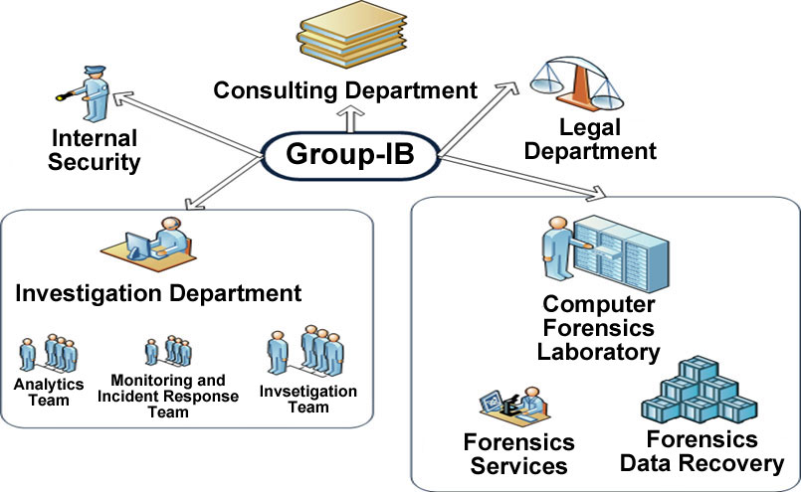
Group-IB
Notes:
6

Slide 7






GROUP-IB Services
Cyber crime investigations
Incident response
DDoS prevention and protection
Law enforcment
Forensic lab
Internet banking fraud

Slide 8
Group-IB software projects
Group-IB Anti-fraud
GROUP-IB CyberCop System
Group-IB internet brand Guard
GIB anticybercrime software Solutions are new type cloud computing software which helps:
To Detect
To Prevent
To Stop
To Investigate
Notes:
8

Slide 9
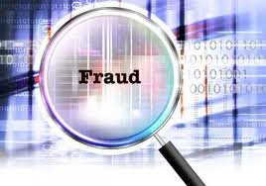
Group-IB Anti-fraud software
More than 100 successful fraudulent transactions every day, losses for 2010 in Russia = $500 000 000
GIB Anti-Fraud Solution: the solution that can control the security of your clients and help you to protect their money
Internet-banking system audit
Antimalware protection
Fraud detection
Prevention from remote banking frauds
Evidence collection

Slide 10
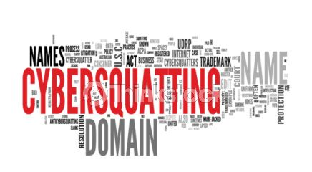
Group-IB internet brand Guard
GIB Brand Guard Solution protect the most important what you have – REPUTATION. It is priceless.
GIB Brand Guard Solution is a new type cloud computing software:
24*7 online monitoring
online detection of misuse of brand in Internet
cybersquatting protection
antifishing
prevention from false association

Slide 11
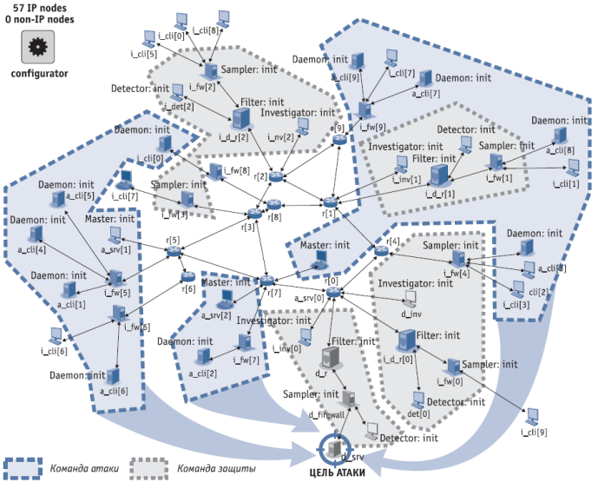
Group-IB CyberCop System
GIB CyberCop System: the system that can save
$ millions per day
Protection against DDoS-attack
GIB HoneyNet (30 000 honeypots)
24*7 online monitoring
43 countries around the world
ProActive Incident Response
Immediate response to the threat
Prevent, protect and identify
Notes:
11

Slide 12
Investigation of Information security incidents
Group-IB performs the entire spectrum of work connected with violation of information security private and legal personality:
Restoring timeline of event;
Detection causes of incident;
Detection persons involved in incident;
Information security support for prevention incidents;
Legal support.

Slide 13

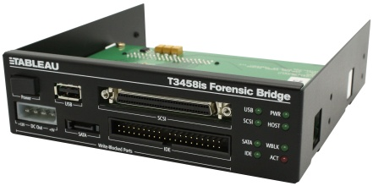
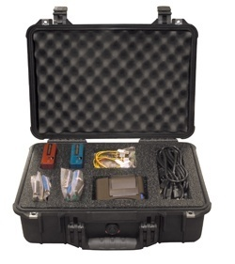
Forensic lab
Group-IB has one of the best laboratories in Russia for carrying out forensic researches and data recovery
We have the advanced equipment for carrying out of the most difficult researches
  Our equipment allows to collect as fast as possible proofs with maintenance of their safety and an invariance
  Hardware reduce time of gathering of proofs for 40 %
  The equipment for data recovery allows to restore the valuable information even from technically faulty data carriers
  Hardware accelerators allow to reduce essentially time of selection of the password or a key..
We have the software – recognized as the standard de-facto in the world of computer criminalistics and law enforcement bodies
  The software allows to conduct researches of all known file and operating systems
  Software allow to analyze files of various formats and to take from them necessary proofs
  The software allows to decipher the ciphered contents, to select passwords and confidential keys
Our experts use the advanced techniques of carrying out forensic examinations
The approaches developed in our laboratory to carrying out forensic researches are used in laboratories of the USA and Canada

Slide 14
Incident Response
Service to respond promptly to incidents include:
Immediate consultation certified professionals, with the departure 24 * 7;
Operational development strategies to respond to the incident, taking into account international practices and information security incident management features of your company;
Surgical removal of critical security vulnerabilities and develop recommendations to improve protection of information;
Develop and implement a plan for investigation of the incident;
Rapid provision of information on the initial stage of investigation and recommendations for early recovery of business processes;
Providing a complete list of necessary actions to fully recover after the incident;
Providing a full report, including information on performance;
Meeting participants to work together individuals to discuss the work done to address the incident and clarify all the details.

Slide 15








International partnership
Group-IB works closely with organizations investigate cyber - crime and respond to incidents around the world
Group to respond to incidents (CERT) in 43 countries
Antivirus companies
Forensic companies
Institute of USA and Europe
International Organization of Computer Forensics
ACFE
Interpol division
Centers study of information security threats

Slide 16
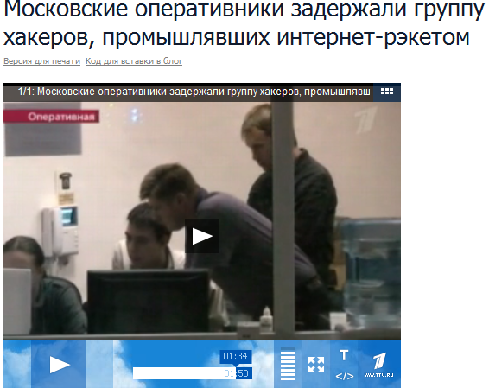


The last high-profile case
Group-IB, Economic Crimes Division and Dept K MVD eliminate a group of hackers who develop and spread of the viruses “ WinLock “.
10 hackers have been arrested
Notes:
16

Slide 17
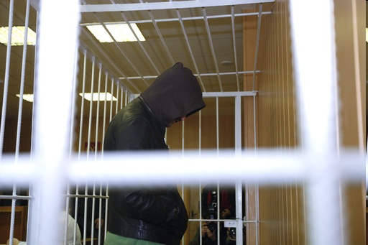
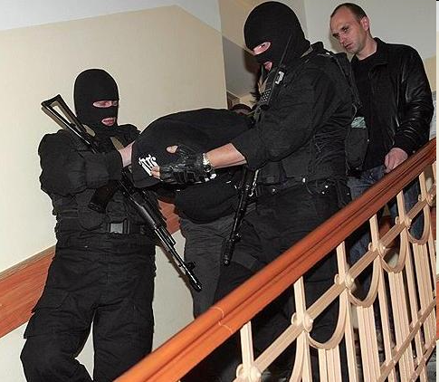
Successful criminal cases
DDoS
Bonnets developing
Internet banking fraud
Malvare developing
Websites hacking
Phishing
Financial fraud
Notes:
17

Slide 18






















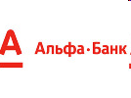

Clients and partners
Notes:
18

Slide 19
Group-IB SOLUTION
GROUP-IB is ready to offer a full range of services to respond to, deter and investigate incidents, aimed at reducing a financial, operational and reputational risks.
1
Develop and formalize a process of incident management.
2
Analysis of the settings systems and IT services to the permanent availability of information necessary for proper and effective response and investigation of incidents.
3
Legal and expert support.
5
Organization of monitoring public networks for handling the brand for the timely response.
6
Phishing protection, monitoring of the Internet.
7
Protection against DDoS (Distributed Denial of Service).
4
Responding to and investigating incidents.
8
Recovering data

Slide 20

Thank you. Questions?
Ilya Sachkov
CEO
Group-IB
sachkov@group-ib.ru
www.group-ib.ru
www.letagroup.ru

